Slide 1
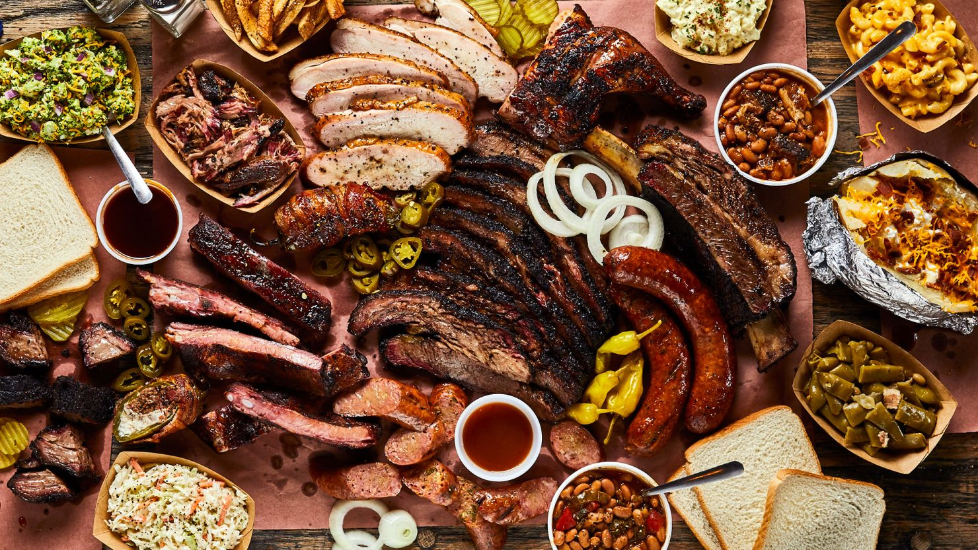
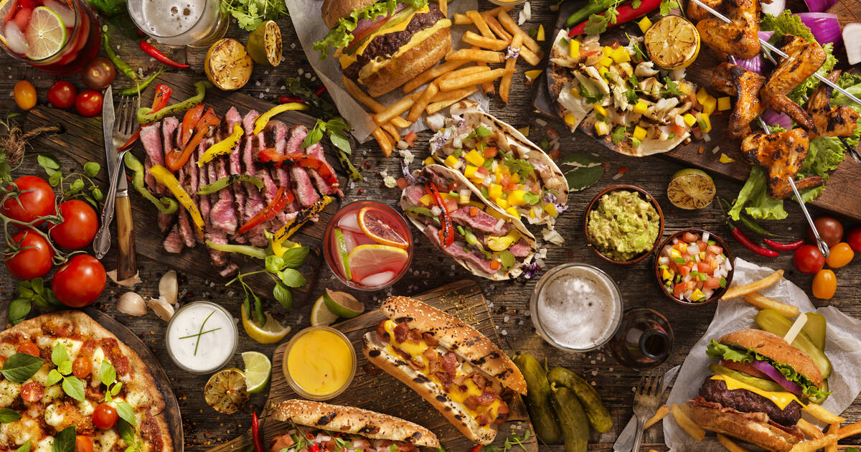

Slide 2







HUNGRY?

Slide 3
HUNGRY?

Slide 4
HANGRY?

Slide 5
FOOD

Slide 6
FOOD
THE MENU
AND RECIPES
If you enjoy a small banter, click “EXIT”
EXIT
ENTER

Slide 7
INSTRUCTIONS:
USE THE ARROWS TO SCROLL THROUGH THE FOOD YOU WANT _______________________________________
CLICK ON THE PHOTO TO VIEW ITS RECIPE _______________________________________
CLICK “DONE!” ON THE MENU TO EXIT
ENTER

Slide 8
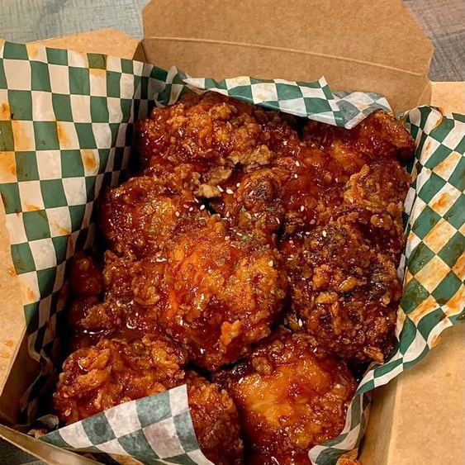
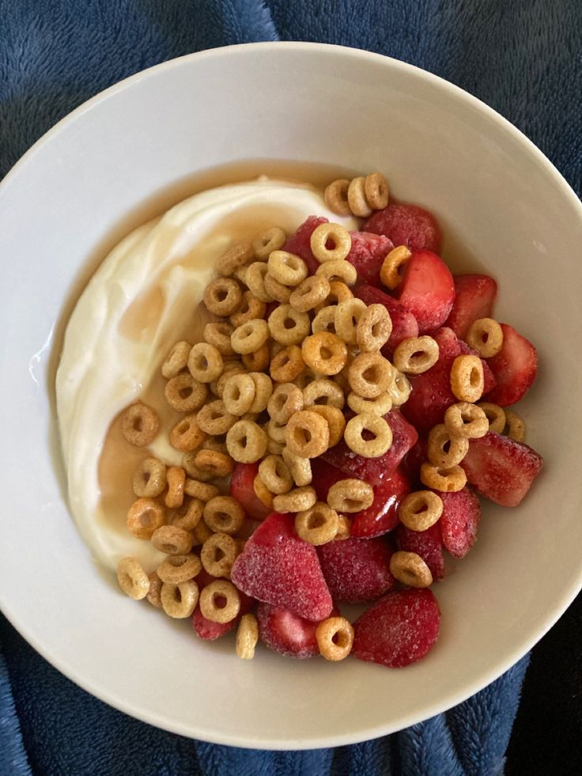
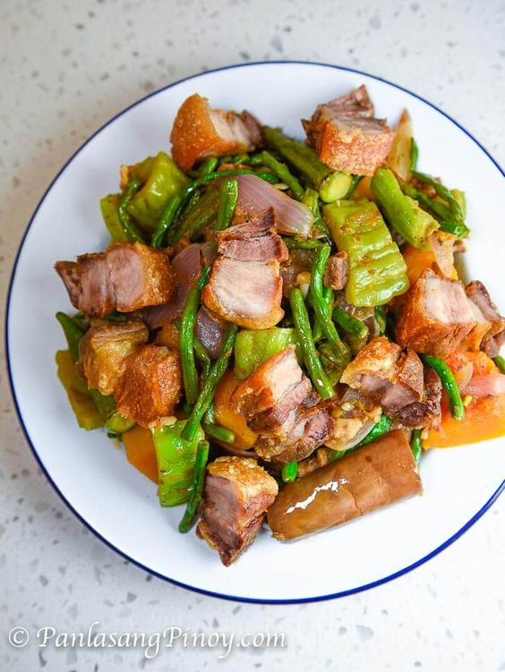
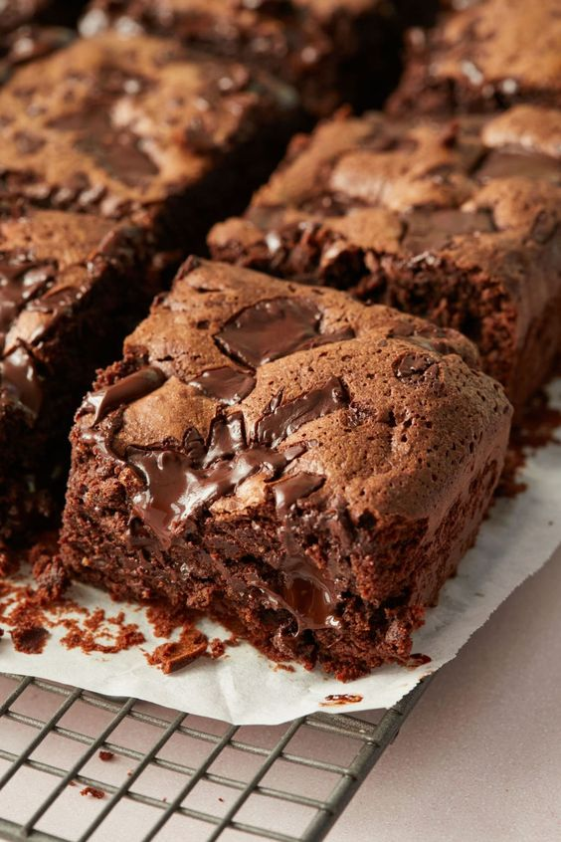
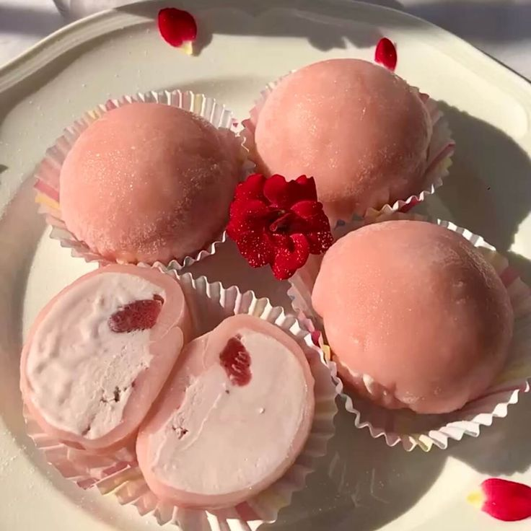
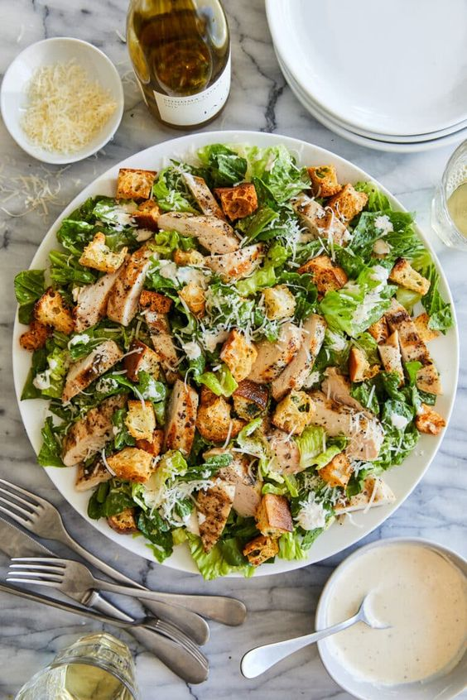
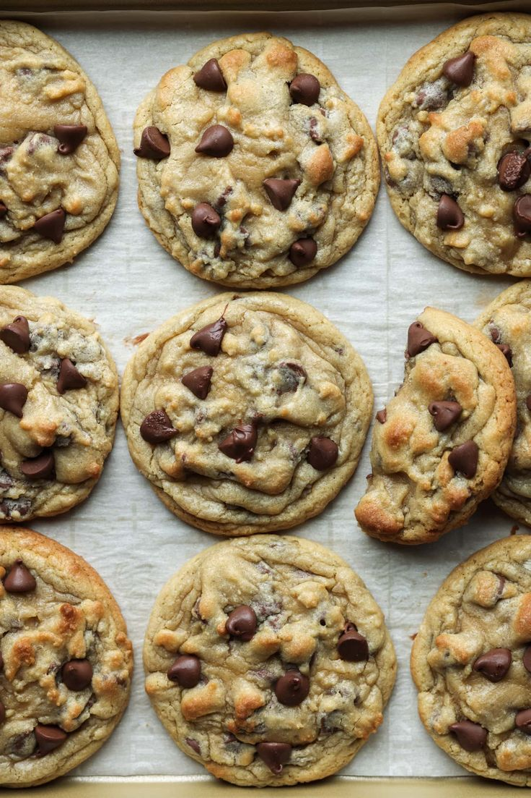
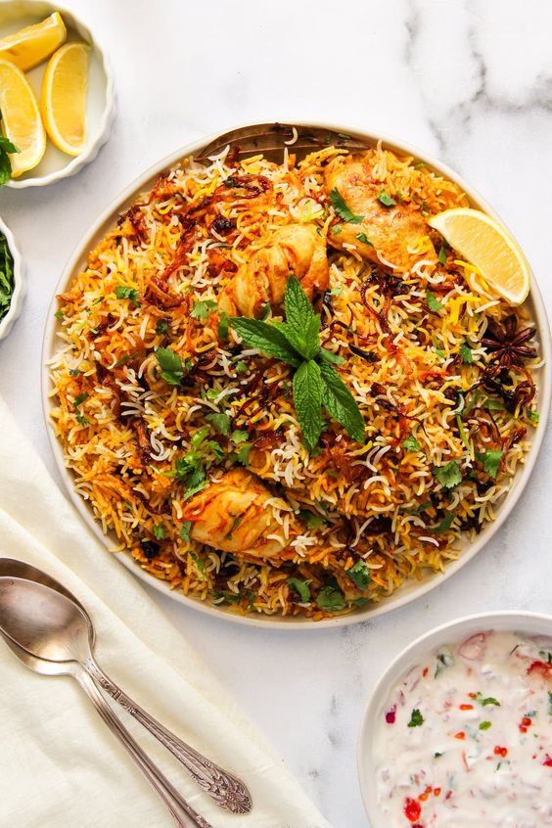

MENU
HOME
DONE!
KOREAN FRIED CHICKEN (Not spicy)

Slide 9
RECIPE
Non-Spicy Korean Fried Chicken Recipe
Ingredients:
For the Chicken:
2 lbs chicken wings or drumsticks
1 teaspoon salt
1/2 teaspoon black pepper
1 tablespoon garlic powder
1 tablespoon onion powder
1 cup all-purpose flour
1/2 cup cornstarch
Oil for frying (vegetable or canola oil)
For the Coating Sauce:
1/4 cup soy sauce
2 tablespoons honey or corn syrup
2 tablespoons ketchup
1 tablespoon rice vinegar or apple cider vinegar
1 tablespoon sesame oil
2-3 cloves garlic, minced
1 teaspoon ginger, minced (optional)
Sesame seeds and chopped green onions for garnish (optional)
Instructions:
Marinate the Chicken:
In a large bowl, season the chicken pieces with salt, black pepper, garlic powder, and onion powder. Let them marinate for at least 30 minutes (or up to 2 hours in the refrigerator).
Prepare the Coating:
In another bowl, combine the flour and cornstarch. This mixture will help create a crispy coating.
Coat the Chicken:
Dredge each piece of marinated chicken in the flour-cornstarch mixture, ensuring they are well coated. Shake off any excess.
Fry the Chicken:
Heat oil in a deep frying pan or pot over medium-high heat. Once the oil is hot (about 350°F or 175°C), carefully add the chicken pieces in batches. Fry for about 10-12 minutes or until golden brown and cooked through. Use a thermometer to check that the internal temperature reaches 165°F (75°C).
Remove the fried chicken and drain on paper towels to remove excess oil.
Make the Coating Sauce:
In a small saucepan, combine the soy sauce, honey (or corn syrup), ketchup, vinegar, sesame oil, minced garlic, and ginger (if using). Cook over low heat, stirring until the mixture is well combined and slightly thickened, about 2-3 minutes.
Coat the Fried Chicken:
In a large mixing bowl, add the fried chicken pieces and drizzle the sauce over them. Toss gently to coat each piece evenly with the sauce.
Serve:
Transfer the coated chicken to a serving platter. Garnish with sesame seeds and chopped green onions if desired. Serve warm with rice or on its own!
Tips:
For extra crunch, you can double-fry the chicken: fry it once, let it rest for a few minutes, and then fry again for 3-4 minutes.
You can adjust the sweetness of the sauce by adding more or less honey/corn syrup according to your taste.
Serve with a side of pickled radishes or a refreshing salad to balance the dish.
DONE

Slide 10
MENU
HOME
DONE!
FROZEN YOGURT

Slide 11
RECIPE
Frozen Yogurt Bowls Recipe
Ingredients:
2 cups plain Greek yogurt (or any yogurt of your choice)
2 tablespoons honey or maple syrup (adjust to taste)
1 teaspoon vanilla extract (optional)
Fresh fruits (e.g., berries, banana slices, mango, kiwi)
Granola or nuts (for crunch)
Chia seeds or flaxseeds (optional)
Chocolate chips or coconut flakes (optional)
Instructions:
Prepare the Yogurt:
In a bowl, mix the Greek yogurt with honey (or maple syrup) and vanilla extract until smooth and well combined.
Spread the Yogurt:
Spread the yogurt mixture evenly on a baking sheet lined with parchment paper, about 1/2 inch thick. You can also use silicone molds for a fun shape.
Freeze:
Place the baking sheet in the freezer and freeze for about 3-4 hours, or until the yogurt is completely frozen.
Break into Pieces:
Once frozen, remove the yogurt from the freezer and let it sit for a few minutes to soften slightly. Then, break it into bite-sized pieces.
Assemble the Bowls:
In serving bowls, add a layer of frozen yogurt pieces. Top with your choice of fresh fruits, granola, nuts, seeds, chocolate chips, or coconut flakes.
Serve Immediately:
Enjoy your frozen yogurt bowls right away for a refreshing treat!
Tips:
Feel free to customize your yogurt base by adding flavors like cocoa powder, fruit puree, or spices like cinnamon.
You can also create a parfait by layering yogurt and toppings in a glass for a visually appealing dessert.
Store any leftovers in an airtight container in the freezer, though they’re best enjoyed fresh!
DONE

Slide 12
MENU
HOME
DONE!
PINAKBET WITH LECHON KAWALI

Slide 13
RECIPE
Pinakbet with Lechon Kawali Recipe
Ingredients:
For the Lechon Kawali:
1 lb (450g) pork belly, cut into large chunks
4 cups water
1 tablespoon salt
1/2 teaspoon black peppercorns
2-3 cloves garlic, crushed
Oil for frying
For the Pinakbet:
1 tablespoon cooking oil
1 onion, chopped
2-3 cloves garlic, minced
1-2 tomatoes, chopped
1 cup water or broth
1 cup squash (kalabasa), cubed
1 cup eggplant, sliced
1 cup bitter melon (ampalaya), sliced (optional)
1 cup string beans (sitaw), cut into 2-inch pieces
2-3 tablespoons shrimp paste (bagoong)
Salt and pepper to taste
Chili peppers (optional, for heat)
Instructions:
For the Lechon Kawali:
Boil the Pork:
In a pot, combine the pork belly, water, salt, peppercorns, and crushed garlic. Bring to a boil over medium heat. Reduce to a simmer and cook for about 45 minutes to 1 hour, or until the pork is tender.
Cool and Fry:
Remove the pork from the pot and let it cool. Once cool, pat it dry with paper towels to remove excess moisture. Heat oil in a deep pan over medium-high heat. Once the oil is hot, fry the pork belly until golden brown and crispy on all sides. Drain on paper towels and set aside.
For the Pinakbet:
Sauté the Aromatics:
In a large skillet or wok, heat the cooking oil over medium heat. Sauté the chopped onions until translucent, then add the minced garlic and chopped tomatoes. Cook until the tomatoes are soft.
Add Water/Broth:
Pour in the water or broth and bring it to a simmer.
Cook the Vegetables:
Add the cubed squash and cook for about 5-7 minutes until slightly tender. Then, add the eggplant, bitter melon, and string beans. Stir to combine.
Season:
Add the shrimp paste and mix well. Season with salt and pepper to taste. You can also add chili peppers for extra heat. Let the vegetables cook until tender but still vibrant in color, about 5-7 more minutes.
Serve: 7. Plate the Dish:
Serve the Pinakbet hot, topped with crispy Lechon Kawali on the side. Enjoy it with steamed rice!
Tips:
You can customize the vegetables according to your preference or availability.
If you prefer a healthier version, you can skip frying the pork and instead roast or grill it until crispy.
Leftover Lechon Kawali can be used in various dishes, so feel free to make extra!
DONE

Slide 14
MENU
HOME
DONE!
BROWNIES

Slide 15
RECIPE
Classic Brownies Recipe
Ingredients:
1/2 cup (1 stick) unsalted butter
1 cup granulated sugar
2 large eggs
1 teaspoon vanilla extract
1/3 cup unsweetened cocoa powder
1/2 cup all-purpose flour
1/4 teaspoon salt
1/4 teaspoon baking powder
1/2 cup chocolate chips or nuts (optional)
Instructions:
Preheat the Oven:
Preheat your oven to 350°F (175°C). Grease an 8x8-inch baking pan or line it with parchment paper for easy removal.
Melt the Butter:
In a medium saucepan, melt the butter over low heat. Once melted, remove from heat and let it cool slightly.
Mix in Sugar and Eggs:
Stir the sugar into the melted butter until combined. Add the eggs one at a time, mixing well after each addition. Then stir in the vanilla extract.
Combine Dry Ingredients:
In a separate bowl, whisk together the cocoa powder, flour, salt, and baking powder.
Mix Everything Together:
Gradually add the dry ingredients to the wet mixture, stirring until just combined. Be careful not to overmix. If desired, fold in the chocolate chips or nuts.
Pour into the Pan:
Pour the brownie batter into the prepared baking pan, spreading it evenly.
Bake:
Bake in the preheated oven for 20-25 minutes, or until a toothpick inserted into the center comes out with a few moist crumbs (not wet batter).
Cool and Serve:
Allow the brownies to cool in the pan for about 10 minutes, then lift them out using the parchment paper (if used) and let them cool completely on a wire rack. Cut into squares and enjoy!
Tips:
For extra fudgy brownies, be careful not to overbake them; they should still be soft in the center.
You can add mix-ins like white chocolate chips, caramel, or your favorite nuts for variety.
Serve the brownies warm with a scoop of vanilla ice cream for a delicious dessert!
DONE

Slide 16
MENU
HOME
DONE!
MOCHI

Slide 17
RECIPE
Mochi Recipe
Ingredients:
1 cup sweet rice flour (mochi flour or glutinous rice flour)
1/4 cup granulated sugar
1 cup water
Cornstarch or potato starch (for dusting)
Optional Fillings:
Sweetened red bean paste (anko)
Ice cream (for mochi ice cream)
Fruit slices (like strawberries)
Instructions:
Prepare the Mixture:
In a microwave-safe bowl, combine the sweet rice flour, granulated sugar, and water. Stir until the mixture is smooth and well combined.
Cook the Mixture:
Cover the bowl with plastic wrap, leaving a small vent for steam to escape. Microwave the mixture on high for about 1 minute. Remove, stir, and then microwave for an additional 1-2 minutes, stirring every minute, until the mixture becomes thick and sticky.
Cool the Mochi:
Once cooked, let the mochi cool for a few minutes. Dust a clean surface or a baking sheet with cornstarch or potato starch to prevent sticking.
Shape the Mochi:
Transfer the sticky mochi onto the dusted surface. Dust your hands with cornstarch and knead it gently for a few seconds until it’s manageable. Divide the mochi into small portions (about 1-2 tablespoons each).
Add Fillings (Optional):
If you’re adding fillings, flatten each portion of mochi and place a small amount of filling (like red bean paste or a scoop of ice cream) in the center. Carefully wrap the mochi around the filling, pinching the edges to seal it.
Dust and Store:
Dust the finished mochi with additional cornstarch to prevent them from sticking together. You can enjoy them immediately or store them in an airtight container in the refrigerator for up to a few days.
Tips:
If you want to make Mochi Ice Cream, shape the mochi into larger discs and freeze them after wrapping the ice cream inside.
For different flavors, you can mix in a few drops of food coloring or flavor extracts (like matcha or vanilla) into the mochi mixture before cooking.
Be careful when handling hot mochi, as it can be very sticky and may burn if it comes into contact with your skin.
Enjoy your homemade mochi! Let me know if you have any questions or need variations!
DONE

Slide 18
MENU
HOME
DONE!
CHICKEN CEASAR SALAD

Slide 19
RECIPE
Chicken Caesar Salad Recipe
Ingredients:
For the Salad:
2 boneless, skinless chicken breasts
1 tablespoon olive oil
Salt and pepper, to taste
6 cups romaine lettuce, chopped
1/2 cup cherry tomatoes, halved (optional)
1/4 cup grated Parmesan cheese
1 cup croutons (store-bought or homemade)
For the Caesar Dressing:
1/4 cup mayonnaise
2 tablespoons Dijon mustard
1 tablespoon lemon juice
2 teaspoons Worcestershire sauce
1 garlic clove, minced
Salt and pepper, to taste
2 tablespoons grated Parmesan cheese (optional)
Instructions:
Prepare the Chicken:
Preheat your grill or skillet over medium-high heat.
Brush the chicken breasts with olive oil and season with salt and pepper.
Grill or cook the chicken for about 6-7 minutes per side, or until the internal temperature reaches 165°F (75°C). Let it rest for a few minutes before slicing.
Make the Caesar Dressing:
In a bowl, whisk together the mayonnaise, Dijon mustard, lemon juice, Worcestershire sauce, minced garlic, salt, and pepper until smooth. If desired, mix in the additional Parmesan cheese for extra flavor.
Assemble the Salad:
In a large bowl, toss the chopped romaine lettuce with the Caesar dressing until evenly coated.
Add the sliced chicken on top, along with cherry tomatoes and croutons.
Sprinkle with grated Parmesan cheese.
Serve:
Divide the salad into serving bowls or plates and enjoy immediately!
Tips:
For added flavor, marinate the chicken in olive oil, lemon juice, garlic, and herbs before cooking.
You can add anchovies to the dressing for a more traditional flavor if you like.
To make homemade croutons, toss cubed bread with olive oil, garlic powder, salt, and Italian herbs, then bake at 400°F (200°C) until golden and crispy.
DONE

Slide 20
MENU
HOME
DONE!
CRUMBL COOKIES (Chocolate Chip)

Slide 21
RECIPE
Crumbl Chocolate Chip Cookies Recipe
Ingredients:
1 cup unsalted butter, softened
1 cup granulated sugar
1 cup brown sugar, packed
2 large eggs
2 teaspoons vanilla extract
4 cups all-purpose flour
1 teaspoon baking soda
1 teaspoon salt
2 cups semi-sweet chocolate chips
Instructions:
Preheat your oven to 350°F (175°C). Line baking sheets with parchment paper.
Cream the butter and sugars:
In a large bowl, beat the softened butter, granulated sugar, and brown sugar together until light and fluffy.
Add eggs and vanilla:
Mix in the eggs one at a time, followed by the vanilla extract, until well combined.
Combine dry ingredients:
In another bowl, whisk together the flour, baking soda, and salt.
Mix wet and dry ingredients:
Gradually add the dry ingredients to the wet mixture, mixing until just combined. Avoid overmixing.
Fold in chocolate chips:
Gently fold in the semi-sweet chocolate chips until evenly distributed.
Scoop the dough:
Use a cookie scoop or your hands to form large balls of dough (about 3 tablespoons each) and place them on the prepared baking sheets, spacing them about 2 inches apart.
Bake:
Bake in the preheated oven for 10-12 minutes or until the edges are lightly golden but the centers are still soft.
Cool:
Remove from the oven and let the cookies cool on the baking sheets for about 5 minutes before transferring them to wire racks to cool completely.
Enjoy!:
Serve warm or store in an airtight container for later.
Tips:
For extra flavor, you can add a teaspoon of cornstarch to the dry ingredients.
You can mix different types of chocolate chips (milk chocolate, dark chocolate, or white chocolate) for variety!
DONE

Slide 22
MENU
HOME
DONE!
BIRYANI

Slide 23
RECIPE
Chicken Biryani Recipe
Ingredients:
For the Chicken Marinade:
1 lb (450g) chicken, cut into pieces (bone-in or boneless)
1 cup plain yogurt
2 tablespoons ginger-garlic paste
2 teaspoons red chili powder (adjust to taste)
1 teaspoon turmeric powder
1 tablespoon garam masala
Salt to taste
Juice of 1 lemon
2 tablespoons chopped fresh mint and coriander leaves
For the Rice:
2 cups basmati rice
4 cups water
2-3 whole cloves
2-3 green cardamom pods
1-2 bay leaves
1 stick cinnamon
Salt to taste
For the Biryani:
3 tablespoons ghee (clarified butter) or oil
2 large onions, thinly sliced
1-2 green chilies, slit (optional)
1/4 cup fried onions (for garnish)
Additional mint and coriander leaves for garnish
Instructions:
Marinate the Chicken:
In a large bowl, mix the yogurt, ginger-garlic paste, red chili powder, turmeric, garam masala, salt, lemon juice, and chopped mint and coriander leaves. Add the chicken pieces, coating them well. Cover and marinate for at least 1 hour (or overnight in the refrigerator for best results).
Prepare the Rice:
Rinse the basmati rice in cold water until the water runs clear to remove excess starch. Soak the rice in water for 30 minutes, then drain.
In a large pot, bring 4 cups of water to a boil. Add the soaked rice, cloves, cardamom, bay leaves, cinnamon, and salt. Cook the rice until it’s about 70% done (it should still have a slight bite). Drain and set aside.
Cook the Chicken:
In a large, heavy-bottomed pot or Dutch oven, heat ghee or oil over medium heat. Add the sliced onions and sauté until they are golden brown.
Add the marinated chicken (including the marinade) and green chilies, cooking until the chicken is fully cooked and tender (about 15-20 minutes).
Layer the Biryani:
Once the chicken is cooked, reduce the heat to low. Spread the partially cooked rice over the chicken layer. Gently fluff the rice with a fork to avoid breaking the grains.
Sprinkle fried onions, additional mint, and coriander leaves on top.
Dum Cooking (Steam):
Cover the pot with a tight-fitting lid or seal it with aluminum foil to trap the steam. Cook on low heat for about 20-25 minutes. This allows the flavors to meld and the rice to finish cooking.
DONE

Slide 24

FOOD
THE MENU
AND RECIPES
EXIT
ENTER

Slide 25
FOOD
THE MENU
AND RECIPES
EXIT
ENTER

Slide 26
FOOD
THE MENU
AND RECIPES
EXIT
ENTER

Slide 27
FOOD
THE MENU
AND RECIPES
EXIT
ENTER

Slide 28
FOOD
i-CLICK mo po ung enter
EXIT
ENTER

Slide 29
FOOD
please po.
EXIT
ENTER

Slide 30
FOOD
Ok.
ENTER
EXIT

Slide 31
FOOD
Ok.
ENTER

Slide 32
THANK YOU ! CREATED BY: TENGICAN, MYEISHA RAIA A.
HOME
BACK

